Slide 1
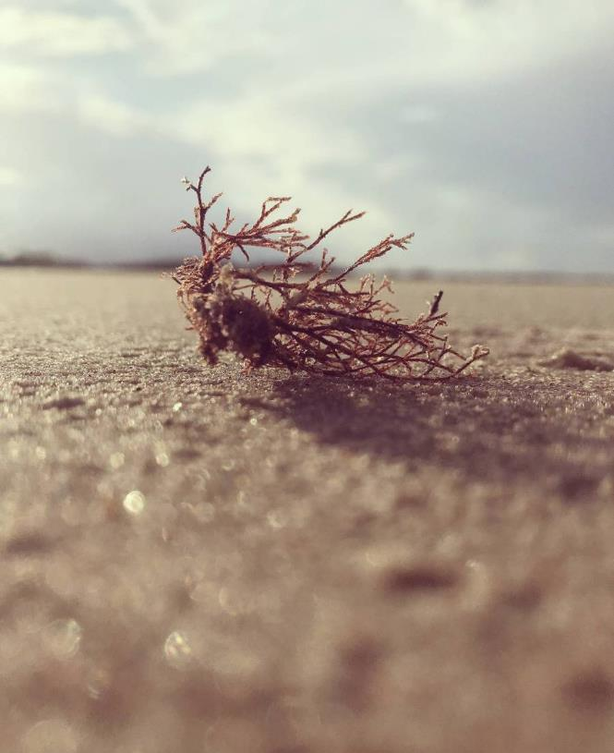
Maine/New England and North Atlantic Groundfish Market Competition Analysis Report
Peizhi Yan, Zhicun Chen, Zican Hao

Slide 2
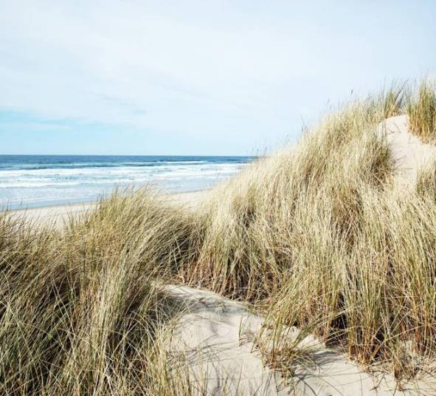
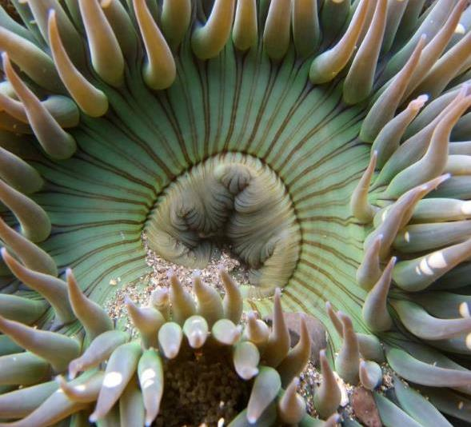
AGENDA
Story
Data
Procedure
Simple Demo
​Q&A

Slide 3
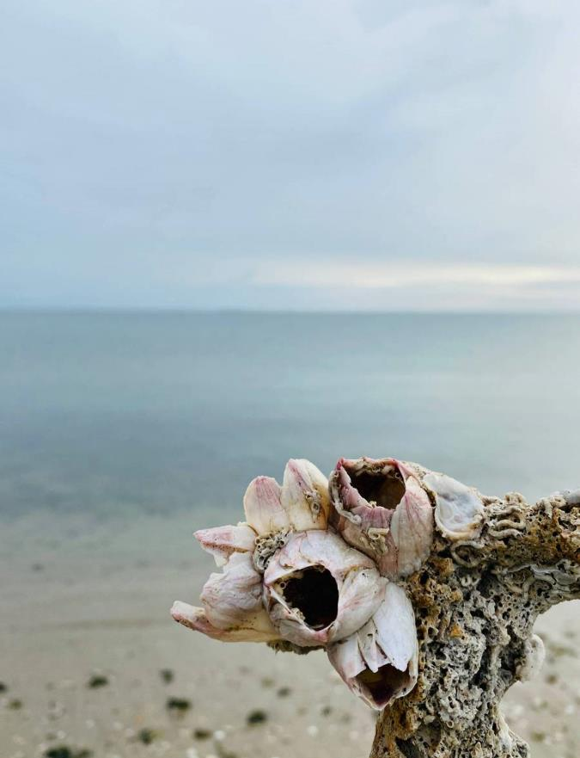
Story
The GMRI Coastal and Marine Economics Lab seeks to understand the mechanisms behind decisions and behaviors related to coastal and marine resource uses. This project focuses on the groundfish. New England is home to a groundfish fishery that produces a variety of whitefish, including species that are culturally important, such as cod and haddock. We also import a large amount of whitefish from the Northeast Atlantic. In other words, locally harvested whitefish directly competes with imports from the Northeast Atlantic. We want to understand the market competition and relationships between New England and Northeast Atlantic (e.g., Norway, Iceland, Scotland).

Slide 4
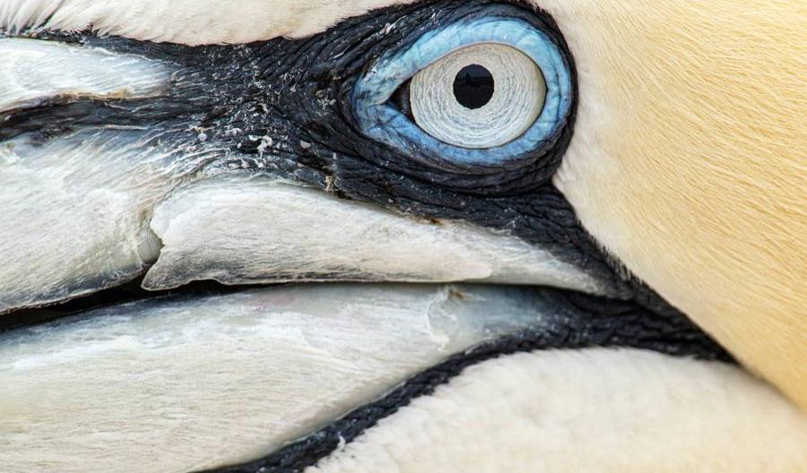
Data and Stakeholder

Slide 5
Data:
Stakerholder
Global: https://www.sea-ex.com/trading/market.htm
Portland Fish Exchange: https://www.pfex.org/price-landing-tool/
NOAA Landings and Foreign Trade: https://www.fisheries.noaa.gov/foss/f?p=215:2:5473541341067
Dr. Kanae Tokunaga, Senior Scientist (ktokunaga@gmri.org), Gulf of Maine Research Institute (GMRI)

Slide 6
TIMELINE OF PROJECT
Data Collection
Exploratory Data Analysis(EDA)
Make conclusion according to the goal
“MVC” design
Generate html page

Slide 7
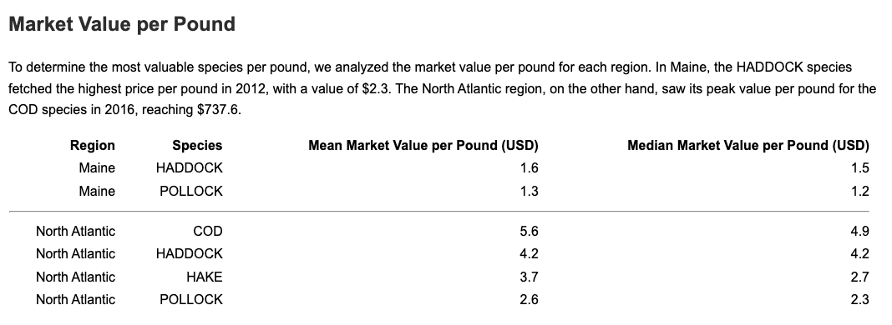
Simple Demo of Auto-generated html page

Slide 8
Next Steps
Unfortunately, due to time constraints, we were unable to develop an interactive web application capable of dynamically generating reports. Given enough time, we will develop this web application to minimize the prerequisite knowledge required for users to generate reports
We may include any predictive analysis in the future research.

Slide 9
Roles and Individual Responsibilities
Peizhi Yan : Data collection, user interface (controller).
Zican Hao : Data collection, template design (view).
Zhicun Chen : Data collection, data calculation and figure generation (model).

Slide 10

Q&A Time

Slide 11

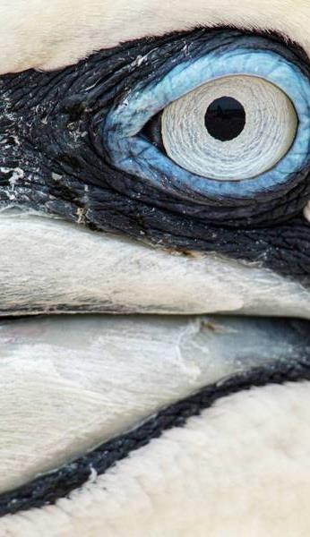
THANK YOU

